Slide 1

Major PROJECT PRESENTATION – II (FreeCom)

Slide 2

Shri Vaishnav Vidhyapeeth Vishwavidyalaya Shri Vaishnav Institute of Information and Technology
Department of Computer Science and Engineering Title: - FreeCom
Subject: - Major Project
Subject Code: - BTCS706
SRS and Conceptual Design
Guided By: -
Mr. Pritesh Kumar Jain
Assistant Professor
CSE Department
SVIIT, SVVV Indore
Presented By: -
Deva Ganesh Nair (19100BTCSAII05257)
Divyam Pithawa (19100BTCSAII05259)
Janish Pancholi (19100BTCSAII05265)
Sarthak Nahar (19100BTCSAII05283)

Slide 3
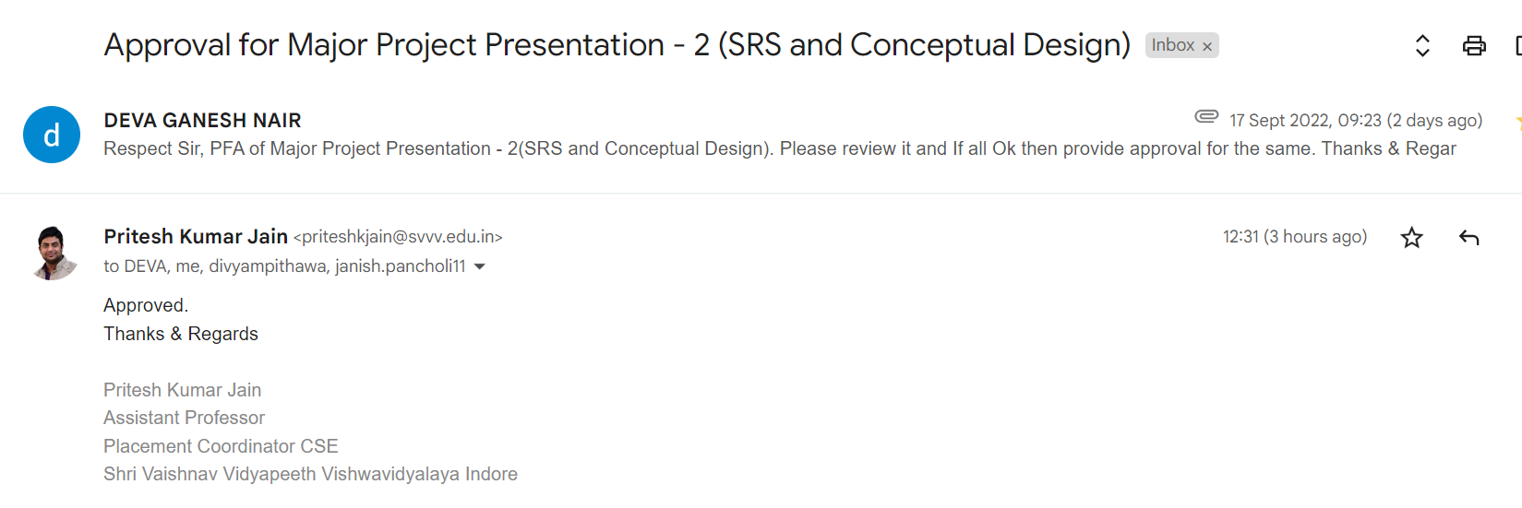
Approval of Presentation from Project Guide

Slide 4
CONTENTS
Introduction
Objectives
Block Diagram
Functional Requirements
Non-Functional Requirements
System Specifications

Slide 5
CONTENTS
Use Case Diagram
Input Process Output (IPO) Diagram
Sequence Diagram
Collaboration Diagram
State Diagram
Activity Diagram

Slide 6
Introduction
1

Slide 7
introduction
In today’s hyper-competitive e-commerce scenario, retail players grab every opportunity to attract potential customers. FreeCom is Web application which will help the customer to make an informed decision while using e-commerce website or retail stores for buying a electronic products.
FreeCom is designed to compare the price and specifications of electronic goods from a range of providers, which will help consumers in making decision to choose products that will save their money through online. It will also provide a mechanism to verify the authenticity of the product by the use of QR code Reader. User/Customers will get creative art/logos/images from the purchases they have made from the brands, and they may get future discount/offers. There is also a trending products panel which will help user to find trending products from Amazon.
2

Slide 8
Objectives
3

Slide 9
Objectives
To compare the prices of the same product from different e-commerce sites and show the cheapest of the two products.
To compare any two electronic devices on the basis of their specifications and show the comparison to the customer.
To ensure the authenticity of the product that the customer bought by scanning the QR code available on the product.
To increase price consciousness among consumers.
Obtaining leads by marketing our web app to consumers who want hassle-free services by providing QR-based comparison in retail stores.
Trending products are displayed to help the companies analyse the trends and the market.
4

Slide 10
Block diagram
5

Slide 11
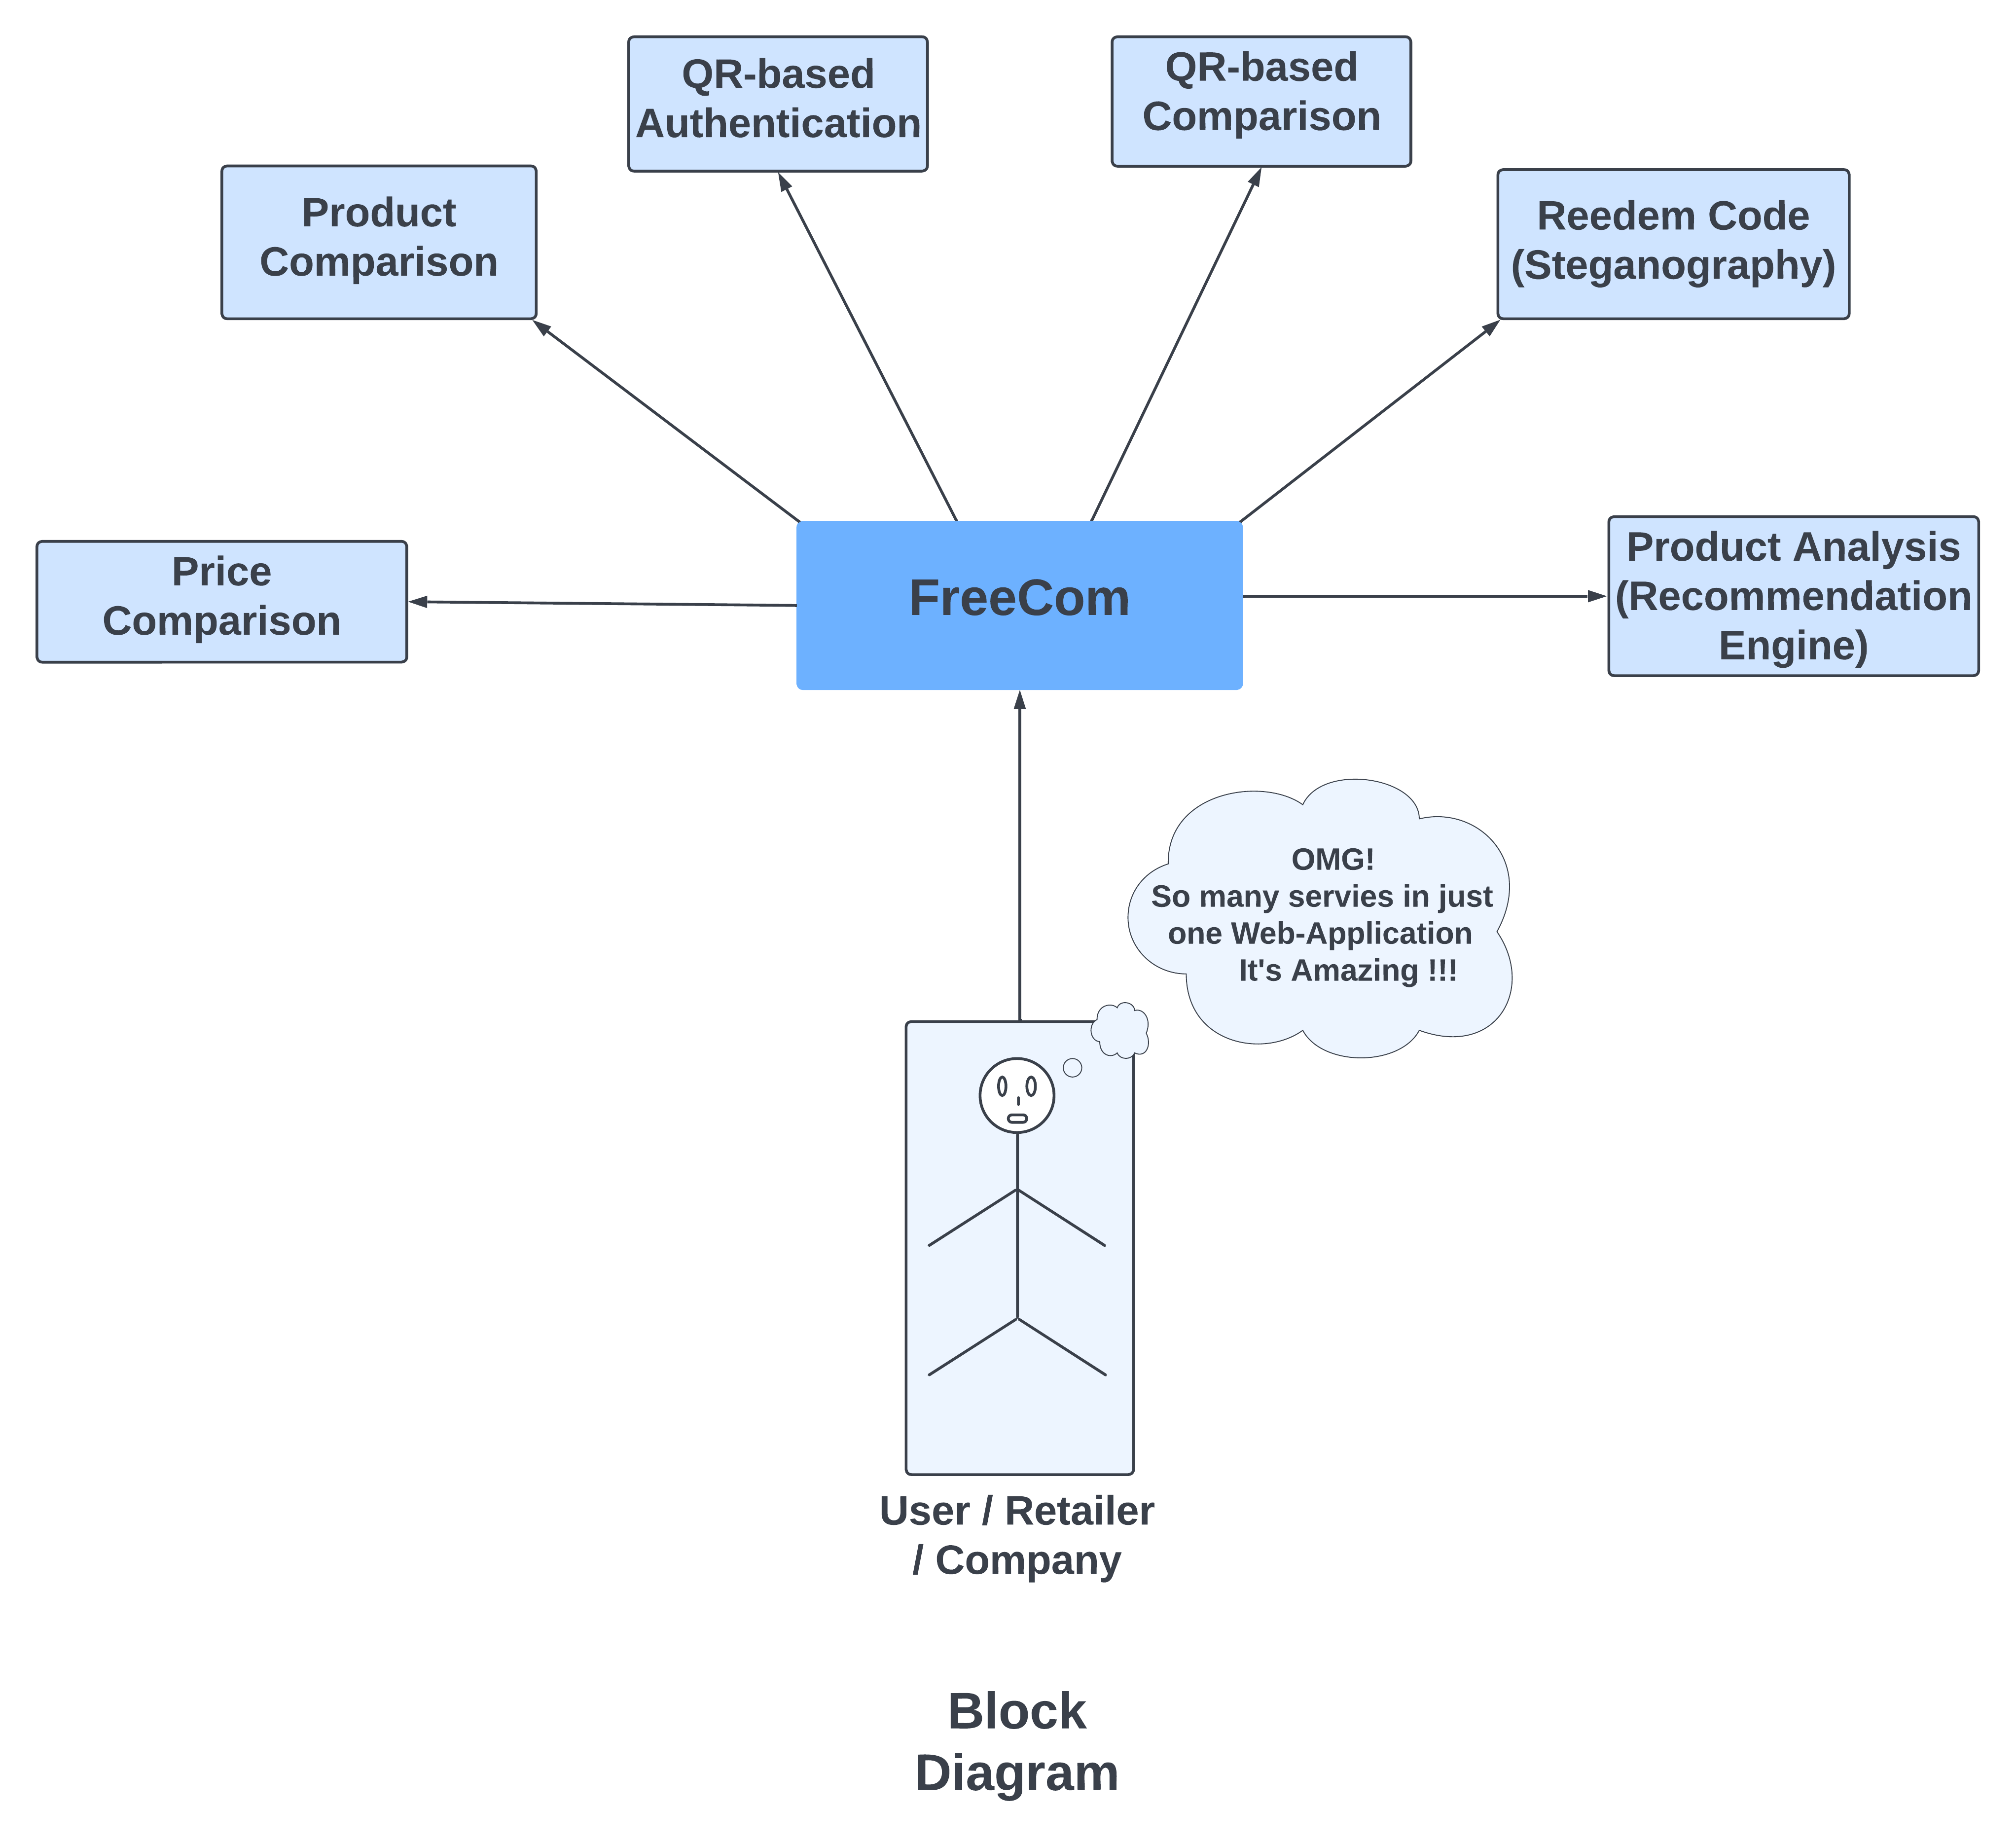
Block diagram
Figure Number - 1
6

Slide 12
Functional Requirements
7

Slide 13
FUNCTIONAL REQUIREMENTS
Price Comparison:
The system must allow the user to enter the product name.
The system must show the result to the user in tabular format.
The system must show the respective link to buy the product for each item in the table.
2. Product Comparison:
The system must allow the user to enter the first product name.
The system must allow the user to enter the second product name.
The system must show the comparison result to the user in tabular format.
3. QR-based authentication:
The system must scan the QR code provided by the user.
The system must decode the QR code.
The system must open the link contained in the code in a new tab for the user to access.
8

Slide 14
FUNCTIONAL REQUIREMENTS
4. QR-based comparison:
The system must scan two QR codes provided by the user for the comparison.
The system must show the comparison result to the user in tabular format.
5. Redeem Code (Steganography)
The system must allow the user to upload the image.
The system must decrypt the image and show the hidden code (if any) to the user.
The system must be able to check the authenticity of the code hidden in the image.
6. Product Analysis (Recommendation Engine):
The system must accept the dataset provided to it by the admin.
The system must prevent any redundancy regarding the dataset.
The system must show the ranked trending products with their image, information, score, and link to buy.
9

Slide 15
Non-Functional Requirements
10

Slide 16
NON FUNCTIONAL REQUIREMENTS
These requirements are listed below.
• The system should perform the process accurately and precisely to avoid problems.
• The system should be easy to modify for any updates. Any errors or bugs that are identified should be easy to mend.
• The system should be easy to understand and use.
• Execution of the operation should be fast.
• The system was user-friendly and consistent
• The system provided an attractive graphical interface for the user The system allowed developer access to the installed environment
• The system focuses targeted customer base.
• The system should not have a fatal error during run time.
11

Slide 17
System Specification
12

Slide 18
SYSTEM SPECIFICATION
Software Requirements:
Technologies used in various modules:
1. Web Scraping: For Product comparison, price comparison, and QR-based comparison.
2. Computer Vision: For QR based authentication and QR based comparison.
3. Pattern Recognition: To Redeem Code (Steganography).
4. Cyber Security: For Redeem Code (Steganography).
5. Data analysis: For price comparison, QR-based comparison, and product analysis (Recommendation Engine).
6. AI: For Product Analysis (Recommendation Engine).
7. API: For Product comparison, QR-based comparison, and product analysis (Recommendation Engine).
13

Slide 19
SYSTEM SPECIFICATION
Hardware Requirements:
OS: Windows 7 & above.
Processor: Intel(R) Dual Core or higher.
RAM: 2.00 GB or greater.
Disk space: At least 100 GB.
Tools used:
1. Jupiter Notebook and VS Code for IDE.
2. Flask framework for creating web applications.
3. HTML, CSS, JavaScript, and Bootstrap V4 for web designing.
4. Anaconda for Python + useful packages.
14

Slide 20
Use Case Diagram
15

Slide 21
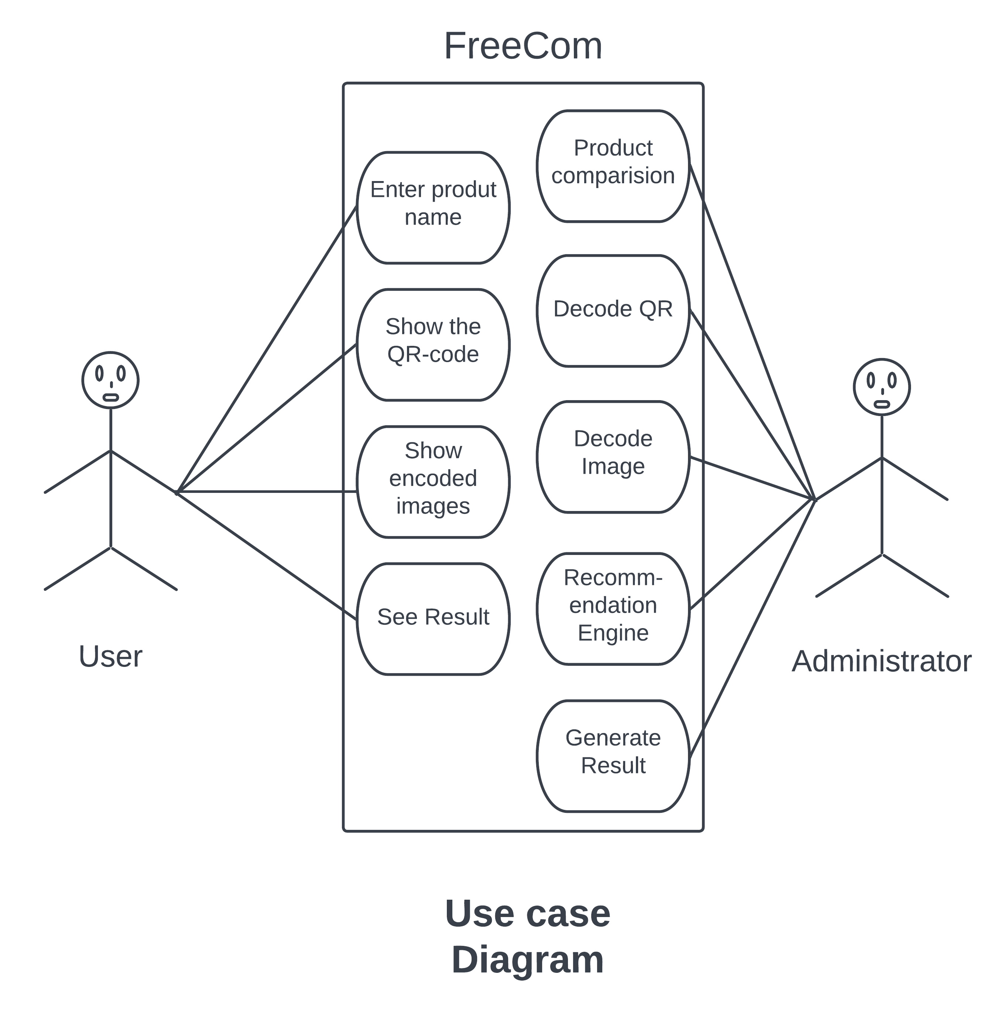
USE CASE diagram
Figure Number - 2
16

Slide 22
Input Process Output (IPO) Diagram
17

Slide 23
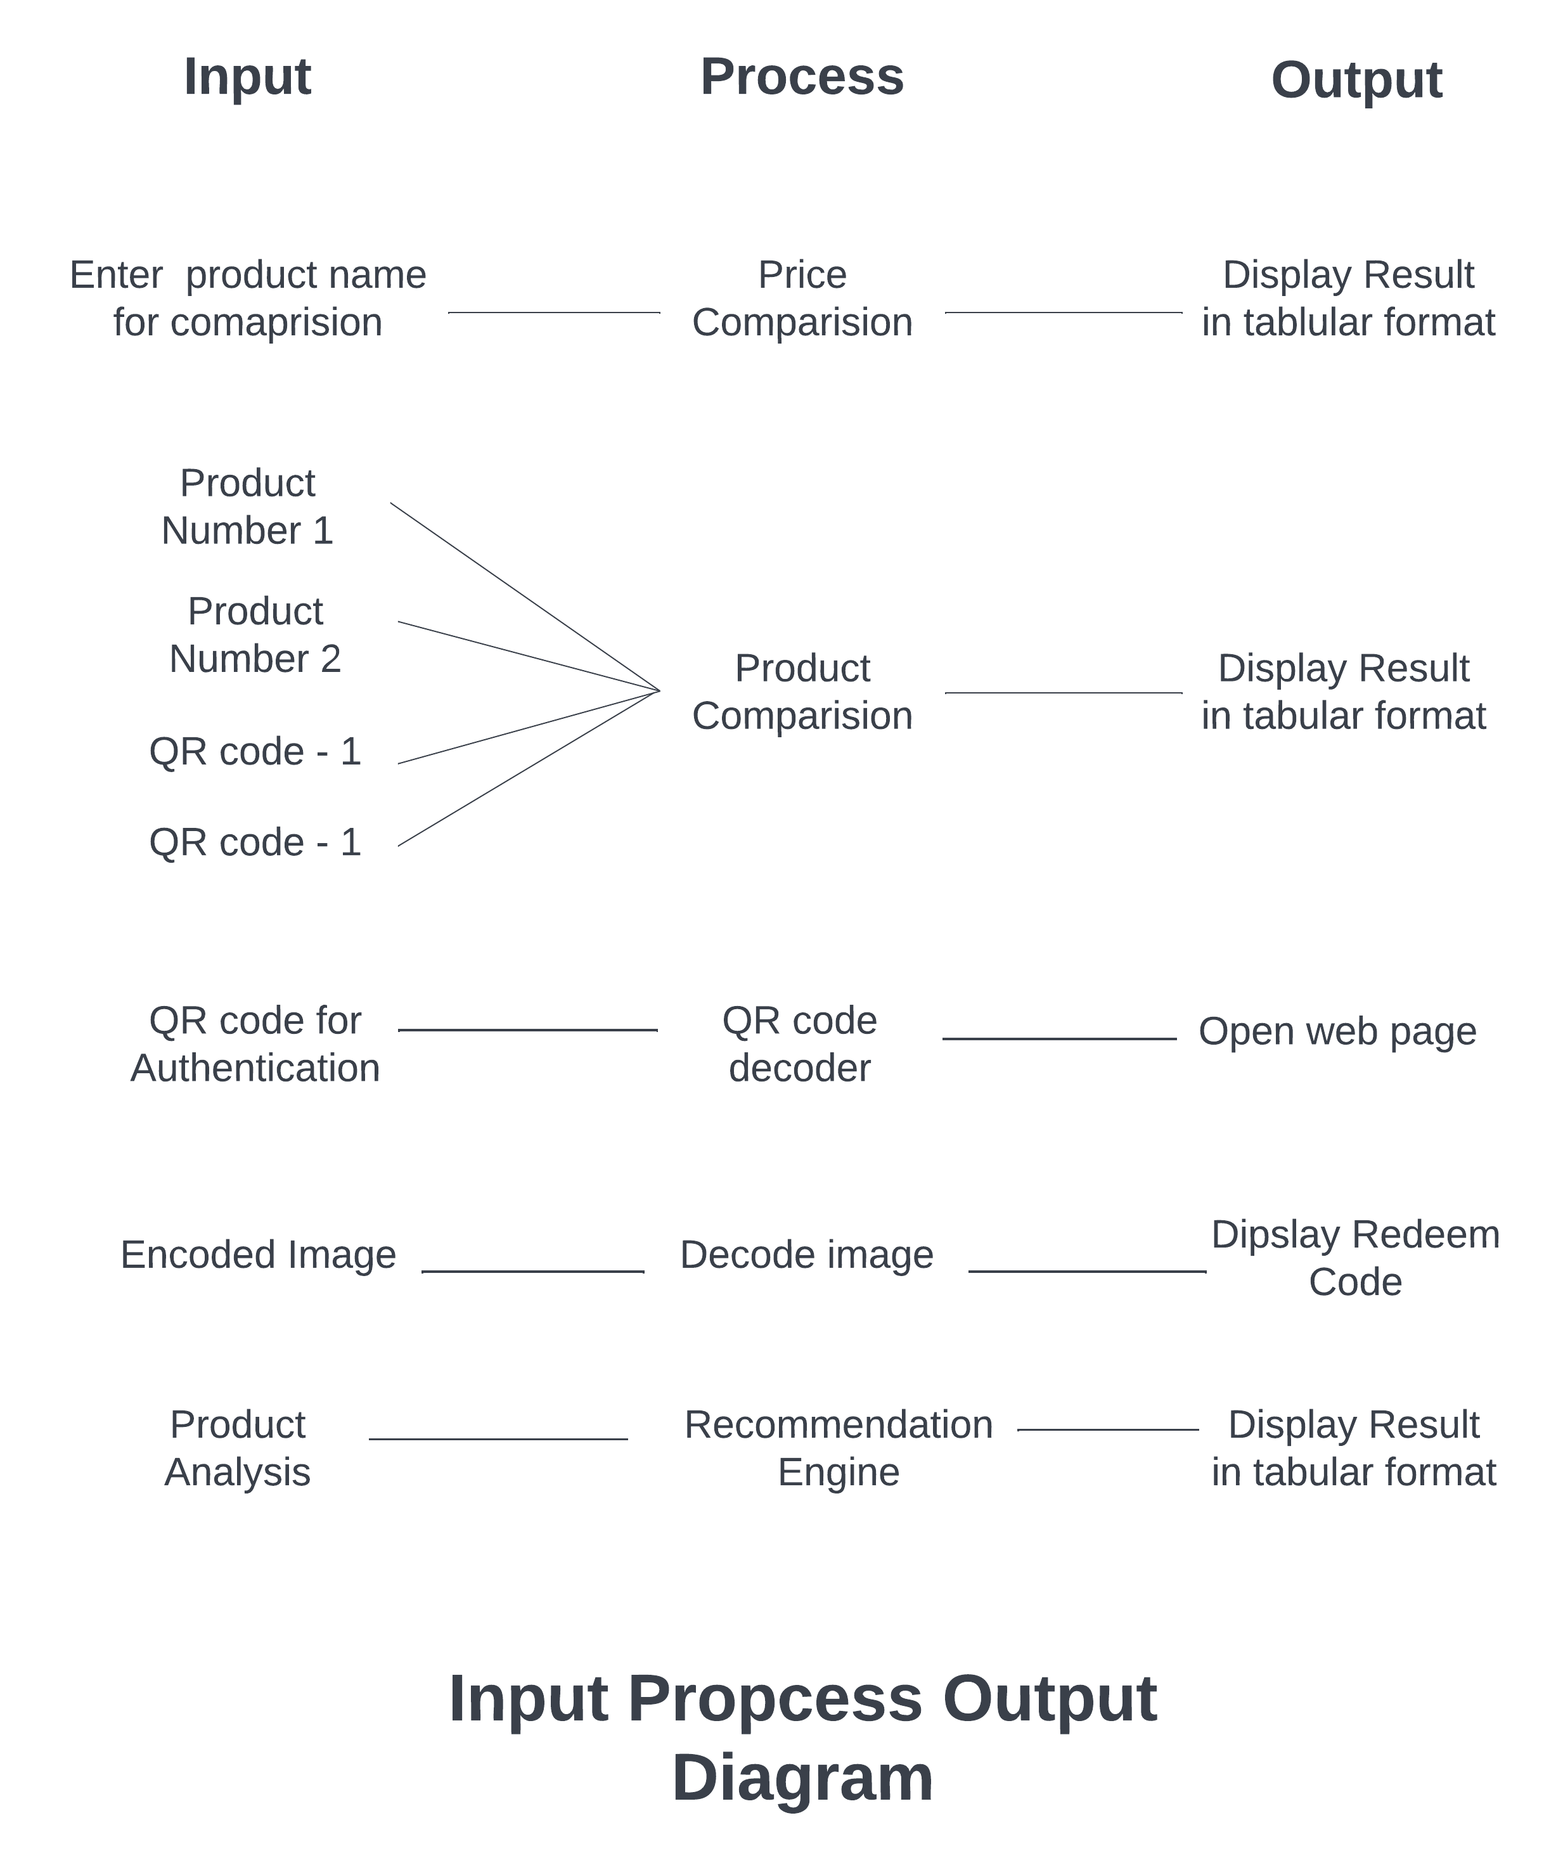
Input Process Output (IPO) Diagram
Figure Number - 3
18

Slide 24
SEQUENCE diagram
19

Slide 25
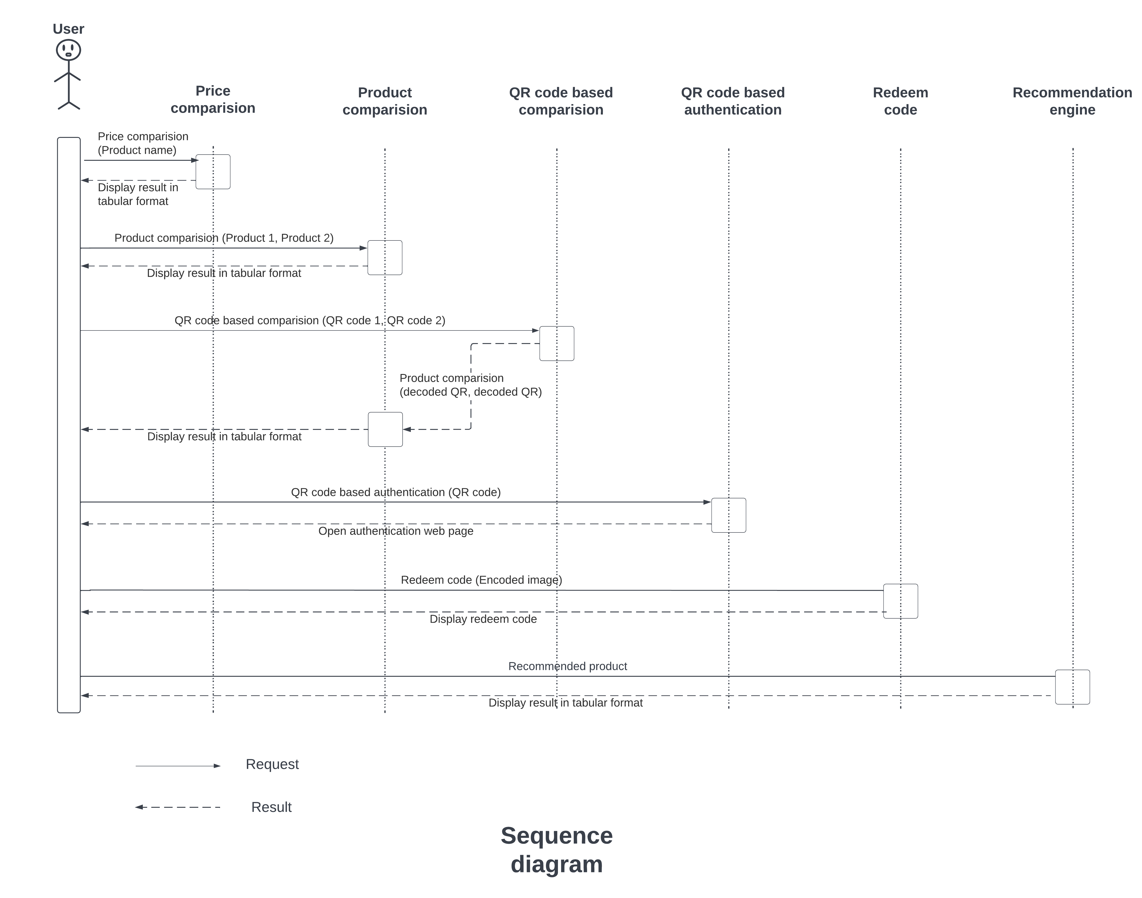
Sequence diagram
Figure Number - 4
20

Slide 26
COLLABORATION diagram
21

Slide 27
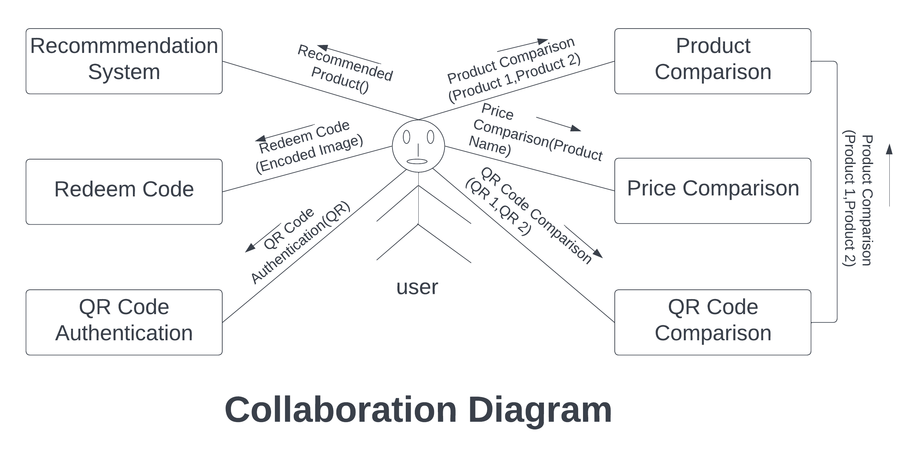
Collaboration diagram
Figure Number - 5
22

Slide 28
STATE diagram
23

Slide 29
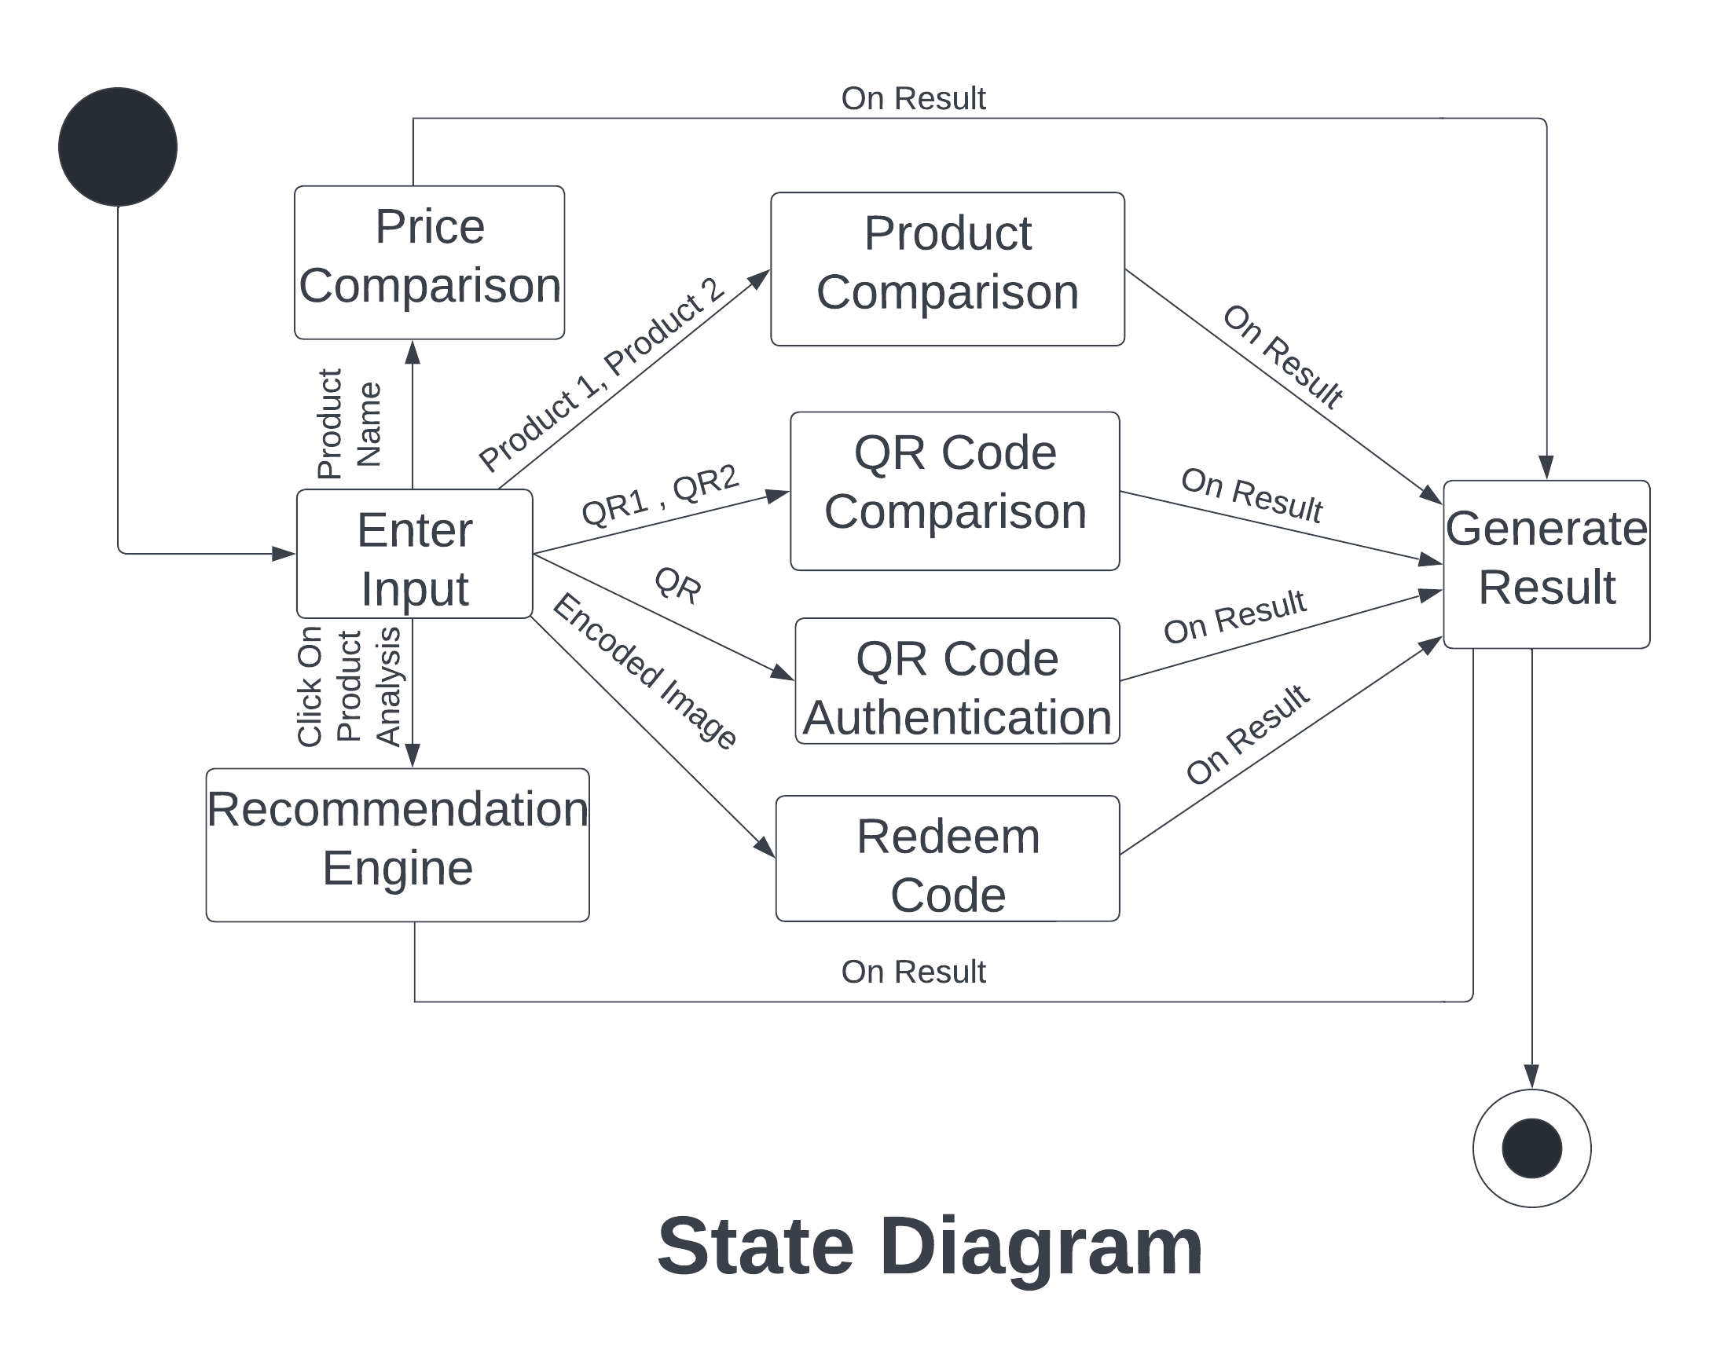
State diagram
Figure Number - 6
24

Slide 30
ACTIVITY diagram
25

Slide 31
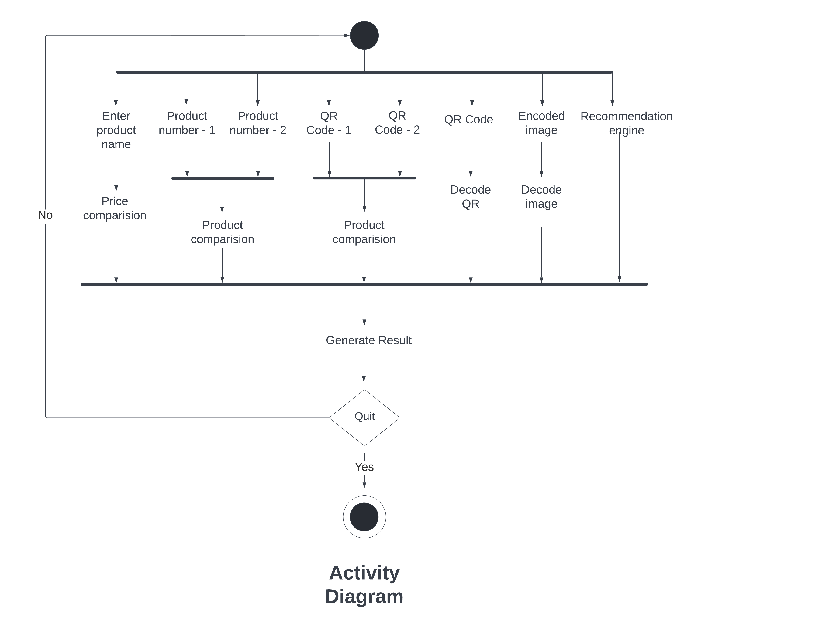
Activity diagram
Figure Number - 7
26

Slide 32
THANK YOU
27

